Slide 1
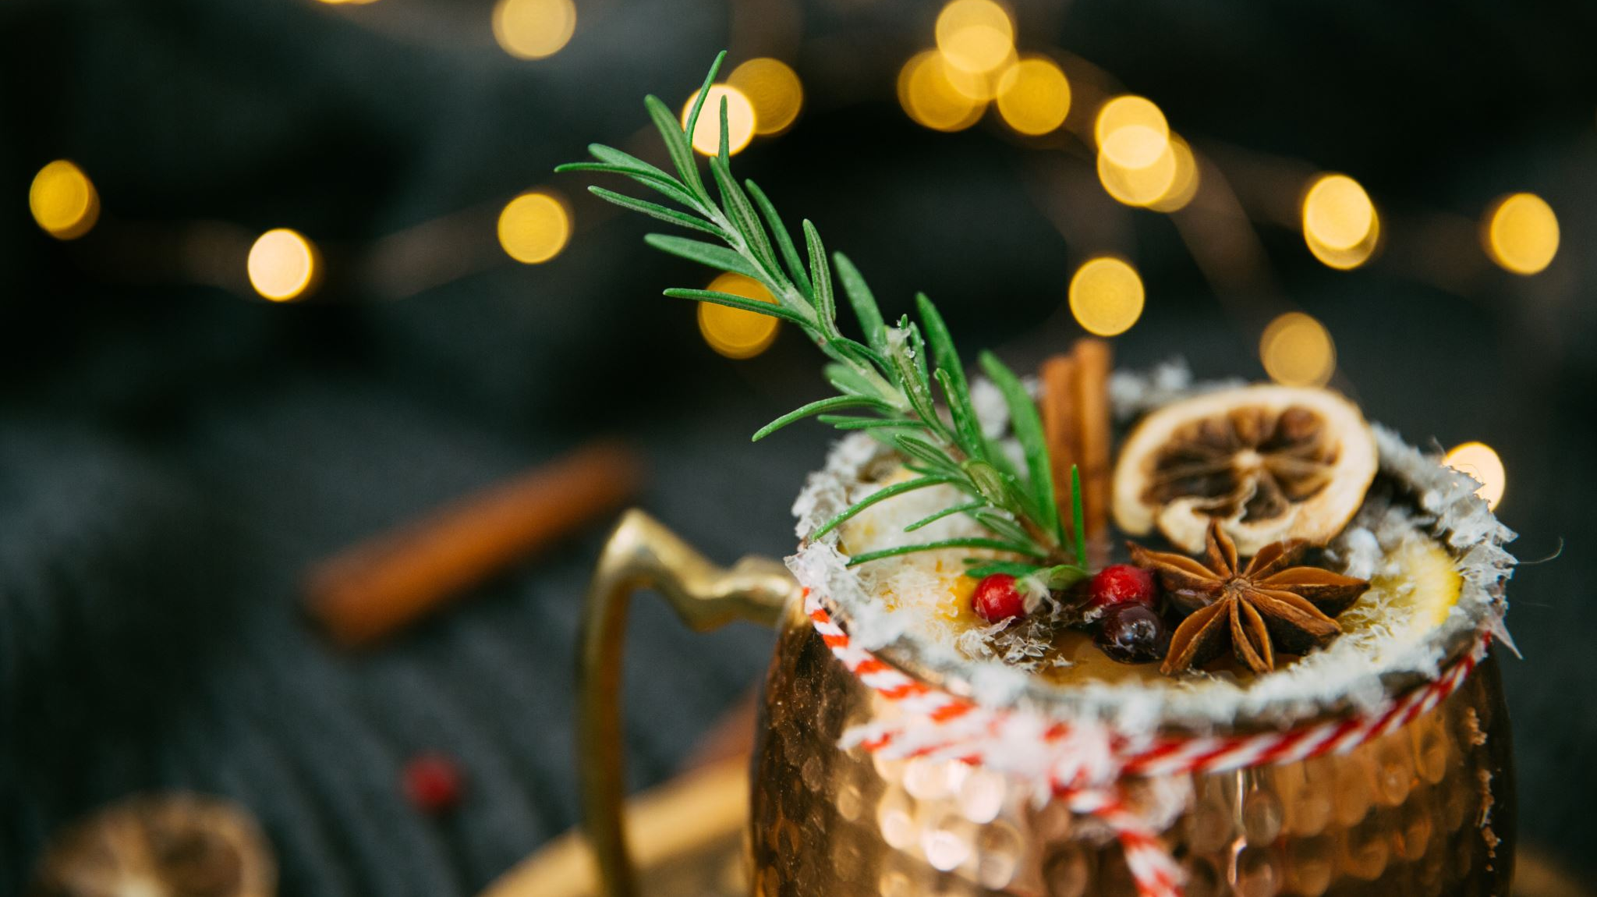
Easy Christmas recipes for the whole family

Slide 2
Gingerbread Mince Pies
You’ll also need
8cm round biscuit cutter
mini gingerbread person biscuit cutter
Ingredients
400g mincemeat (ensure vegetarian, if needed)
50g stem ginger, chopped, plus 1 tbsp ginger syrup from the jar
For the pastry
250g plain flour, plus extra for dusting
¼ tsp ground cinnamon
½ tsp ground ginger
125g cold unsalted butter, cut into small pieces
3 tbsp golden caster sugar, plus extra for sprinkling
1 egg, beaten
Method
STEP 1
For the pastry, tip the flour, spices and butter into a large bowl with a large pinch of salt. Rub together with your fingertips until the mix resembles fine breadcrumbs. Stir in the sugar. Add the egg and use a cutlery knife to mix everything until the ingredients start to clump together. Tip out onto a lightly floured work surface and knead briefly until you have a smooth dough. Or, pulse the ingredients together in a food processor. Shape into a disc, then wrap and chill for at least 30 mins. Will keep chilled for a day or frozen for three months.
STEP 2
Heat the oven to 190C/170C fan/gas 5. Mix the mincemeat with the ginger and syrup. Roll the pastry out on a lightly floured surface to a 3mm thickness. Stamp out 12 discs using an 8cm biscuit cutter and lightly press into a 12-hole cupcake tin.
STEP 3
Fill each pastry case with 1 tbsp of the mincemeat mixture. Re-roll the pastry scraps and stamp out 12 mini gingerbread people, then place one on top of each pie. Will keep frozen for up to two months.
STEP 4
Bake for 20 mins, or 30 mins from frozen. Leave to cool in the tin for 5 mins, then lift out onto a wire rack to cool completely. Dust with icing sugar. Will keep in an airtight container for up to four days.

Slide 3
White Christmas Slice
Ingredients
500 g white chocolate chips
1 1/2 cups Rice Bubbles
100 g red glace cherries
160 g almonds roasted roughly chopped
160 g sultanas
1 cup desiccated coconut
1 tsp vanilla extract
Method
Place chocolate in a heat-proof bowl and cook in the microwave in one minute bursts, stirring between each go, until it has melted. Alternatively, place bowl over a saucepan of simmering water and stir until melted.
Add remaining ingredients to the melted chocolate and stir until combined.
Line a slice tin with baking paper. Pour chocolate mixture into tin and press down firmly. Refrigerate to set.
Drizzle slice with melted dark chocolate. Slice into squares or wedges.

Slide 4
No-bake raspberry chocolate cupcakes
Ingredients
100g bar white chocolate
300g (10oz) Madeira cake
1 medium egg white
60g (2oz) caster sugar
200g tub cream cheese (we used Philadelphia)
100g (31⁄2oz) raspberries
Method
Put the chocolate in a bowl over a pan of simmering water and leave until it melts. Stir and set aside to cool.
Meanwhile, cut the Madeira cake into 8 slices, then roughly crumble each slice at a time and pack the cake crumbs into the cutter. Press it down really well to form a disc of cake. Put this in a muffin case and press into the base. Repeat with the rest of the cake slices.
Whisk the egg white to a stable foam, then whisk in the sugar to glossy peaks. Add the cream cheese to the melted chocolate and mix well, then fold in the meringue mixture and all but 8 of the raspberries. Spoon the mixture on to the cake in the muffin cases. Smooth the tops and pop a raspberry on each one.
Chill until firm — about 2 hours or overnight is fine.

