Slide 1
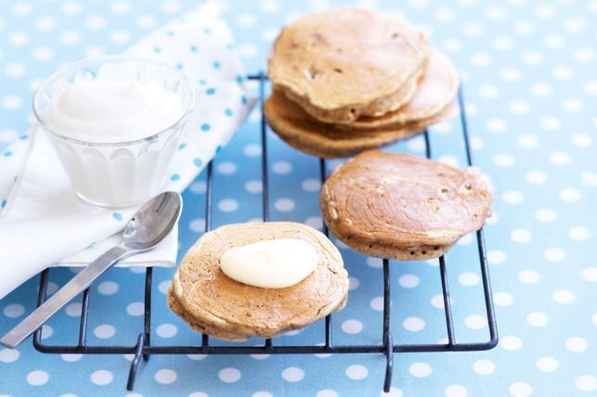
Buckwheat apple and cinnamon pikelets
Ingredients
1 cup plain flour
1/2 cup buckwheat flour (see note)
3 tsp baking powder
1/2 tsp ground cinnamon
1 cup reduced-fat milk
2 eggs
1 tbsp brown sugar
1 medium red apple, peeled, coarsely grated
Olive oil cooking spray
Vanilla yoghurt, to serve
Step 1
Sift flours, baking powder and cinnamon into a bowl. Add milk, eggs, sugar and apple. Stir to combine. Cover with plastic wrap. Refrigerate for 30 minutes.
Step 2
Lightly spray a non-stick frying pan with oil. Heat over medium heat. Using tablespoons of batter at a time, cook pikelets, in batches, for 1 to 2 minutes or until small bubbles form on surface. Turn. Cook for 1 to 2 minutes or until golden and cooked through. Transfer to a wire rack to cool. Serve with yoghurt.

Slide 2
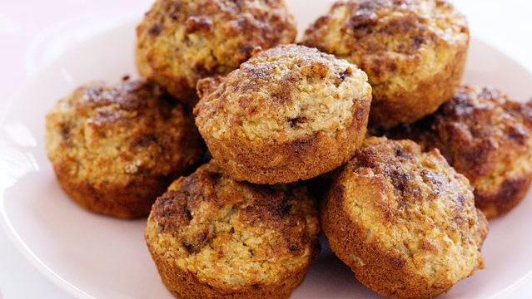
Apple and bran muffins
Ingredients
1 1/2 cups self-raising flour, sifted
1/2 tsp baking powder, sifted
1 1/2 cups wheat bran
2 tbsp brown sugar
1 tsp ground cinnamon
1 large pink lady apple, grated
1 cup reduced-fat milk
1/2 cup Coles Apple Sauce
2 tbsp vegetable oil
1 egg, lightly beaten
Topping
1 tbsp brown sugar
1/2 tsp ground cinnamon
Method:
Preheat oven to 190°C/170°C fan-forced. Grease a 12-hole, 1/3 cup-capacity muffin pan.
Make topping Combine sugar and cinnamon in a bowl. Set aside.
Place flour, baking powder, bran, sugar, cinnamon and apple in a large bowl. Stir to combine. Make a well in centre.
Place milk, apple sauce, oil and egg in a jug. Whisk until just combined.
Pour milk mixture into well. Gently stir until just combined (don’t over-mix). Spoon mixture into prepared pan holes. Sprinkle with topping. Bake for 25 to 27 minutes or until browned and cooked through. Stand in pan for 5 minutes. Transfer to a wire rack to cool. Serve.

Slide 3
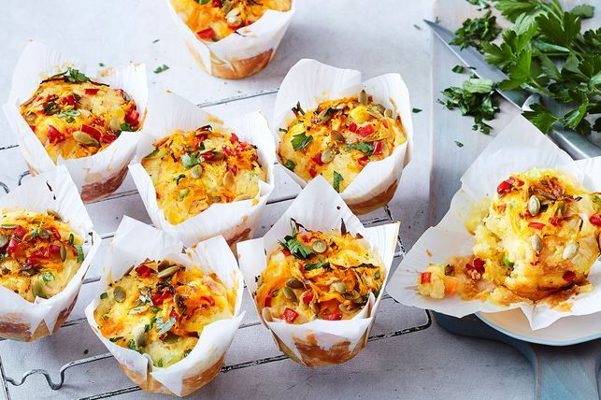
Vegie-loaded pumpkin and cheese muffins
Ingredients
2 cups self-raising flour
1 cup Coles frozen carrot, peas, corn mix
11/4 cups grated tasty cheese
1 leek, white part only, chopped
300g Kent pumpkin, peeled, grated
1 small red capsicum, finely chopped
3/4 cup milk
3 eggs, lightly beaten
3/4 cup sunflower oil
1 tbsp pepitas
2 tbsp coarsely chopped fresh flat-leaf parsley leaves
Method
Preheat oven to 190C/170C fan-forced. Line a 12-hole (1/3-cup-capacity) muffin pan with muffin wraps (see note).
Combine flour, frozen vegetables, cheese, leek, 3/4 of the pumpkin and 3/4 of the capsicum in a large bowl. Whisk milk, eggs and oil in a medium bowl. Add to vegetable mixture. Stir until just combined (do not over-mix).
Divide mixture among prepared holes (chunky bits on top). Top with remaining pumpkin and remaining capsicum. Sprinkle with pepitas. Bake for 25 minutes or until a skewer inserted into the centre comes out clean. Cool in pan for 5 minutes. Transfer to a wire rack to cool. Serve sprinkled with parsley.

Slide 4
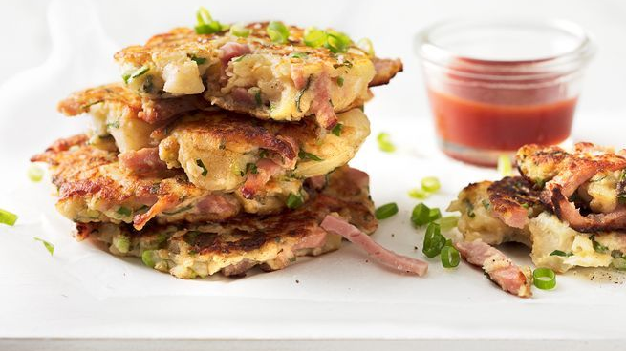
Ham and potato hash browns
Ingredients
3 (350g) brushed potatoes, peeled
150g Primo English Ham, shredded
2 spring onions, chopped
2 tbsp chopped parsley
1 tbsp chopped sage, optional
3 tbsp self-raising flour
3 eggs
20g (1/4 cup) grated parmesan
2 tbsp milk or cream
2 tbsp olive oil
30g butter
Method
Cut potatoes into quarters. Cook in a medium pan of boiling water until just tender. Drain and cool.
Place cooled potatoes in a large bowl. Lightly mash with a potato masher. The mix needs to be quite lumpy. Add ham, spring onions, parsley, sage, flour, eggs, parmesan and milk and season with salt and pepper and mix to combine.
Melt half the oil and butter in a large non-stick frying pan over medium heat. Drop 1/3 cup fulls of mixture into the pan, flattening slightly. Cook, in batches for 2-3 minutes each side or until golden and lightly crisp. Flip and cook remaining sides. Remove and keep warm. Add the remaining oil and butter to cook the second batch. Serve hash browns warm with salt and pepper.

