Slide 1
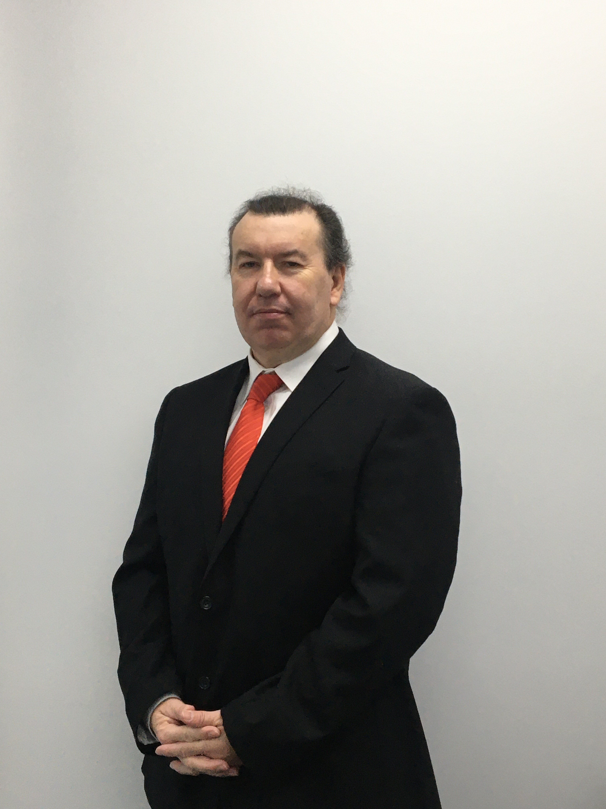
Performance Appraisal Kevin Prendergast CEO Community Management Solutions

Slide 2
Community Management Solutions
Welcome
Introduction
Articles written in newsletter
Frequency of topic from our members
Misunderstood skill
What is it designed to achieve
Do people care anymore
Why is there no time for it

Slide 3
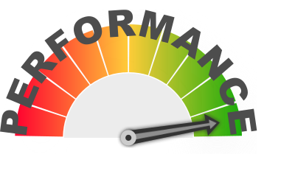
Beginning
What is the goal of the appraisal
Collaboration
Communication
Improvement
Correct misunderstandings
Receive feedback
Active Listening

Slide 4
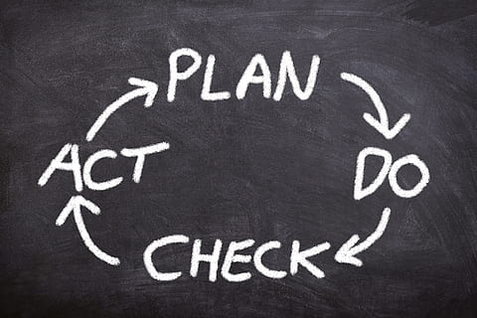
Process
Given the thought and credit that the process deserves
Preparation
How to prepare
Organisation mission and values
Organisation service delivery model
Organisation strategic plan
Organisation operational plan
Organisations current challenges

Slide 5
Individual preparation
Advanced notice to the participant
Initial conversation with the participant
Clear expectations to the participant of what is required prior to the session
Setting adequate time
Setting the adequate space and privacy
If you have a policy have you read it do you understand it and do you follow it?

Slide 6
Documentation
The role of the person who is having the appraisal
The position description
The relevancy and accuracy of the position description
The key critical duties of that position
Any previous performance appraisals
Any incidents that have been raised throughout the previous year or time period
This Photo by Unknown Author is licensed under CC BY

Slide 7
Factors
Develop performance expectations
Develop goals and objectives
Identify performance gaps
How can I (as the manager) support and take a person from A to B
Should there be any surprises at the time of the appraisal and if so why?

Slide 8
Managing performance
This is not a once a year event
Do not wait until the appraisal time
Using an objectionable standard
Observation
Anecdotal
360 degree feedback
Feedback received positive and negative

Slide 9
Self appraisal
Self appraisal compared to your appraisal and is this a difficult conversation and how should you manage this
What are the implications of getting this wrong.
Perception rather than reality.
I am a hard task master (discuss)
What should you be satisfied with.

Slide 10
How to address poor performance
Open, honest and transparent
Honest and clear direction with set goals
Achievable not unachievable
The setting of new Key Performance Indicators
How this can have a detrimental effect on motivation and make someone feel devalued

Slide 11
Definition of an appraisal
“ a periodic and systematic process whereby job performance on an employee is documented and evaluated” .
Discussion
Everyone presumes that a manager or person in authority have an automatic ability or skill to performance manage or measure the performance of others, when this is simply not the case

Slide 12
Why are we doing it
To show we care
For employee retention
To keep people interested in their role
To provide feedback
To give them something to strive for
To modify or correct inappropriate behaviour
To explain this impact on the individual, the team, the organisation and the client/member

Slide 13
If you do it correctly
Your people will feel understood, valued and appreciated
They will understand why their role is important and how to succeed in that role
They will understand the impact that this has on others and the organisation
You will improve personal and team morale
You will improve and align employee culture
You will refocus people who may have become complacent
Receive valuable feedback from the participant (discuss this in detail)

Slide 14
Prepare correctly
Understand your audience
Read all the information carefully
Discuss with relevant others prior to the meeting
Show empathy, courtesy and respect

Slide 15
How to improve
Explain how a person can improve their performance.
What can you provide to the person for them to improve.
Is this training (do not promise what you cannot deliver) , mentoring, coaching, positive affirmation, a review of the role and position description? Are they challenged enough in their current role, or are they treading water?.

Slide 16
Mental Health
Sick leave is higher now than any time in recent memory due to variety of reasons including recovery from the COVID19 pandemic, economic pressure and job security, rising inflation and family pressures, fear of job insecurity.
Figures for the increase in mental health issues for employees is alarming so keep that in mind during this process please.

Slide 17
Management style
What is your management style?
What impacts does this have
Big personality (discuss)

Slide 18
Subconscious Bias
Do you have or could you have a subconscious bias or conflict of interest?
Discuss

Slide 19
Objective Standard
How and what are you going to measure
Once you decide that how are you going to ensure that you have an objective standard
What is the range of tolerance (discuss)
What are and how much should you take into account mitigating factors.
When is there a need for zero tolerance.

Slide 20
How to have that difficult conversation
Courage
Honesty
Supported by evidence not gossip, innuendo or unsubstantiated evidence
How to prepare a performance improvement plan and to explain the ramifications for non compliance. (set realistic time frames and goals)
How to issue formal warnings performance action, suspension, show cause or termination.

Slide 21
The Perfect Employee
Discussion
How does this impact on the review

Slide 22
Halo and Horns
Discuss

Slide 23
How can we help
I will write a number of new articles in our bi monthly newsletter going into much more detail about these topics.
I will be holding an in person training session which you are welcome to attend (at dramatically reduced costs for members)
One of our consultants can visit your organisation and provide direct training which is invaluable to the success of your business.

Slide 24
Any questions
Answer any questions
Summary and discussion

